Slide 1
Case #1: Background
In January 2023, you start a new job as the Packaging-Dunnage Category Manager for Specialty Aluminum Can Manufacturing based in Denver, CO. Your new job reports Global Director of Industrial Supply Procurement. He reports to the CPO.
Specialty Aluminum Can Manufacturing is a global company with 25 locations in the US, 15 in Europe and 8 in South America. Two of the US locations have recently experienced high workforce turnover, and one of the European location is experience energy disruptions. Inflation has been very significant in South America.
The company ships its cans on both plastic and wooden pallets. The pallets have a top frame, layer pads between rows of cans and strapping and stretch film to hold it together. The also buy paper bags for use to ship can ends. Some of the larger suppliers are Orbis and Rehrig
Recently the company has been challenged with global supply disruptions and market inflation. In particular, the company has experienced long lead times for both wooden and plastic pallets, top frames and layer pads. All of these are in your area of spend.
Your department Data Analyst, has sent you a file with 2022 spend.

Slide 2
Case #1: The Ask
Your supervisor comes to you and says, “The CPO and CFO just asked me how much do we spend on Packaging-Dunnage. I told them I think it is $2M. They have asked for us to start a category review of this area. They want to see spend (including by geography), some of the market trends and a list of questions for our key stakeholders in this area. I have set up a meeting with the CPO and CFO to review this in a week.”
At a minimum, this will require
A detailed spend analysis with total category spend, spend by sub-category, supplier, and spend by region. We would expect to see things like top 5 suppliers, number of total suppliers and pareto of how many suppliers represent the 80% of the spend
Identification of the top 5-10 issues / trends this category might face in the next 2-3 years
Interview template for key stakeholders

Slide 3
Case #1: The Assignment
You will be expected to turn in two documents:
Spend Analysis showing how completed the ask (in Excel)
Power point slides on market research and a list of stakeholder questions
You will also be expected to do approximately 5-8 minute video to present your findings. The video should be as if you were presenting to the CPO/CFO. At least two of you should speak. You should focus on
Executive Summary
Category Background – What is this area of spend
Spend Overview
Market Research Findings
Stakeholder Interview question
Recommendations / Next Steps in this Category
DUE SUBMITTED TO CANVAS BY 5pm on April 2nd

Slide 4
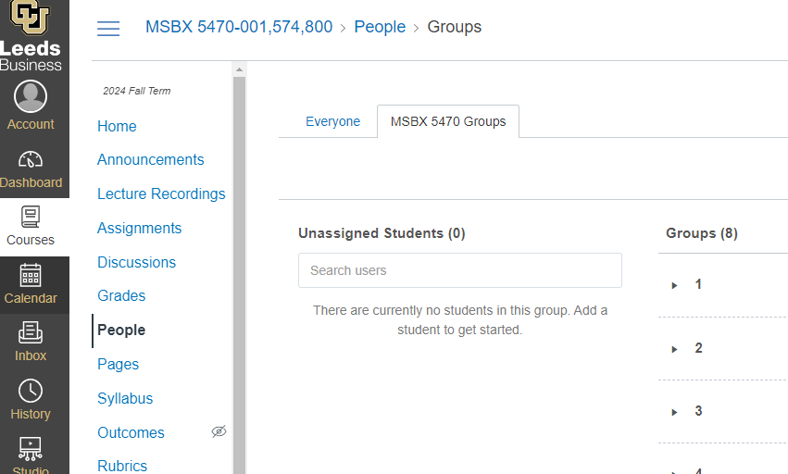
Case Group Assignments

